Slide 1
Relation
Definition: A relation is a named, two-dimensional table of data
Table consists of rows (records) and columns (attribute or field)
Requirements for a table to qualify as a relation:
  It must have a unique name
  Every attribute value must be atomic (not multivalued, not composite)
  Every row must be unique (can’t have two rows with exactly the same values for all their fields)
  Attributes (columns) in tables must have unique names
  The order of the columns must be irrelevant
  The order of the rows must be irrelevant
NOTE: all relations are in 1st Normal form

Slide 2
Correspondence with E-R Model
Relations (tables) correspond with entity types and with many-to-many relationship types
Rows correspond with entity instances and with many-to-many relationship instances
Columns correspond with attributes
NOTE: The word relation (in relational database) is NOT the same as the word relationship (in E-R model)

Slide 3

Key Fields
Keys are special fields that serve two main purposes:
  Primary keys are unique identifiers of the relation in question. Examples include employee numbers, social security numbers, etc. This is how we can guarantee that all rows are unique
  Foreign keys are identifiers that enable a dependent relation (on the many side of a relationship) to refer to its parent relation (on the one side of the relationship)
Keys can be simple (a single field) or composite (more than one field)
Keys usually are used as indexes to speed up the response to user queries (More on this in Ch. 6)

Slide 4
Integrity Constraints
Domain Constraints
  Allowable values for an attribute. See Table 5-1
Entity Integrity
  No primary key attribute may be null. All primary key fields MUST have data
Action Assertions
  Business rules. Recall from Ch. 4

Slide 5
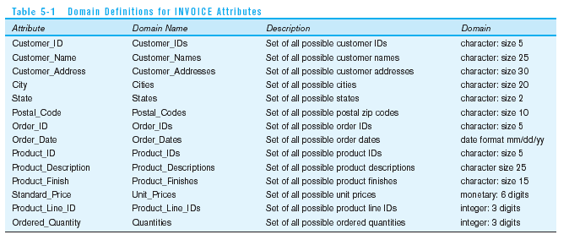
Domain definitions enforce domain integrity constraints

Slide 6
Integrity Constraints
Referential Integrity–rule states that any foreign key value (on the relation of the many side) MUST match a primary key value in the relation of the one side. (Or the foreign key can be null)
  For example: Delete Rules
    Restrict–don’t allow delete of “parent” side if related rows exist in “dependent” side
    Cascade–automatically delete “dependent” side rows that correspond with the “parent” side row to be deleted
    Set-to-Null–set the foreign key in the dependent side to null if deleting from the parent side → not allowed for weak entities

Slide 7
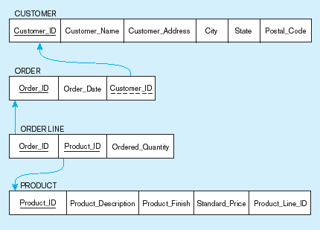
Figure 5-5
Referential integrity constraints (Pine Valley Furniture)
Referential integrity constraints are drawn via arrows from dependent to parent table

Slide 8
Transforming EER Diagrams into Relations
Mapping Regular Entities to Relations
  Simple attributes: E-R attributes map directly onto the relation
  Composite attributes: Use only their simple, component attributes
  Multivalued Attribute–Becomes a separate relation with a foreign key taken from the superior entity

Slide 9


Figure 5-8 Mapping a regular entity
(a) CUSTOMER entity type with simple attributes
(b) CUSTOMER relation

Slide 10


Figure 5-9 Mapping a composite attribute
(a) CUSTOMER entity type with composite attribute
(b) CUSTOMER relation with address detail

Slide 11

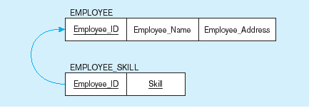
Figure 5-10 Mapping an entity with a multivalued attribute
(a)
Multivalued attribute becomes a separate relation with foreign key
(b)
One–to–many relationship between original entity and new relation

Slide 12
Transforming EER Diagrams into Relations (cont.)
Mapping Weak Entities
  Becomes a separate relation with a foreign key taken from the superior entity
  Primary key composed of:
    Partial identifier of weak entity
    Primary key of identifying relation (strong entity)

Slide 13
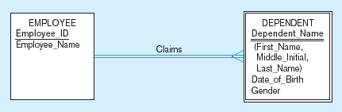
Figure 5-11 Example of mapping a weak entity
a) Weak entity DEPENDENT

Slide 14
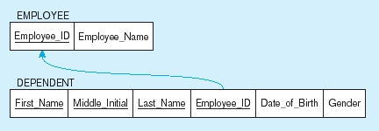
Figure 5-11 Example of mapping a weak entity (cont.)
b) Relations resulting from weak entity
NOTE: the domain constraint for the foreign key should NOT allow null value if DEPENDENT is a weak entity
Foreign key
Composite primary key

Slide 15
Transforming EER Diagrams into Relations (cont.)
Mapping Binary Relationships
  One-to-Many–Primary key on the one side becomes a foreign key on the many side
  Many-to-Many–Create a new relation with the primary keys of the two entities as its primary key
  One-to-One–Primary key on the mandatory side becomes a foreign key on the optional side

Slide 16
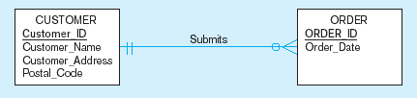
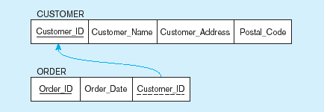
Figure 5-12 Example of mapping a 1:M relationship
a) Relationship between customers and orders
Note the mandatory one
b) Mapping the relationship
Again, no null value in the foreign key…this is because of the mandatory minimum cardinality
Foreign key

Slide 17
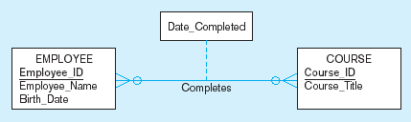
Figure 5-13 Example of mapping an M:N relationship
a) Completes relationship (M:N)
The Completes relationship will need to become a separate relation

Slide 18
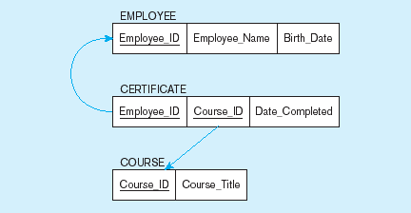
Figure 5-13 Example of mapping an M:N relationship (cont.)
b) Three resulting relations
Composite primary key
Foreign key
New intersection relation
Foreign key

Slide 19
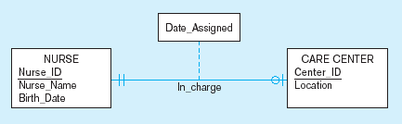
Figure 5-14 Example of mapping a binary 1:1 relationship
a) In_charge relationship (1:1)
Often in 1:1 relationships, one direction is optional.

Slide 20
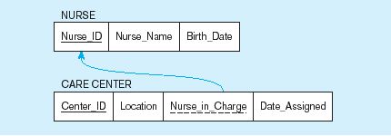
Figure 5-14 Example of mapping a binary 1:1 relationship (cont.)
b) Resulting relations
Foreign key goes in the relation on the optional side,
Matching the primary key on the mandatory side

Slide 21
Transforming EER Diagrams into Relations (cont.)
Mapping Associative Entities
  Identifier Not Assigned
    Default primary key for the association relation is composed of the primary keys of the two entities (as in M:N relationship)
  Identifier Assigned
    It is natural and familiar to end-users
    Default identifier may not be unique

Slide 22
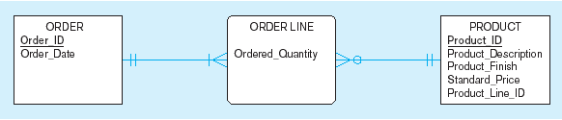
Figure 5-15 Example of mapping an associative entity
a) An associative entity

Slide 23
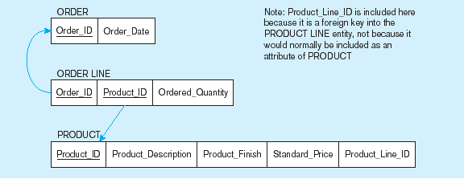
Figure 5-15 Example of mapping an associative entity (cont.)
b) Three resulting relations
Composite primary key formed from the two foreign keys

Slide 24

Figure 5-16 Example of mapping an associative entity with
an identifier
a) SHIPMENT associative entity

Slide 25
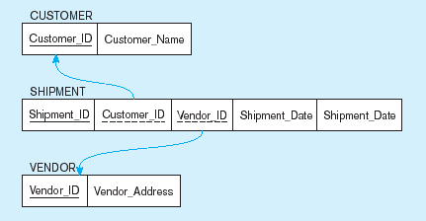
Figure 5-16 Example of mapping an associative entity with
an identifier (cont.)
b) Three resulting relations
Primary key differs from foreign keys

Slide 26
Transforming EER Diagrams into Relations (cont.)
Mapping Unary Relationships
  One-to-Many–Recursive foreign key in the same relation
  Many-to-Many–Two relations:
    One for the entity type
    One for an associative relation in which the primary key has two attributes, both taken from the primary key of the entity

Slide 27
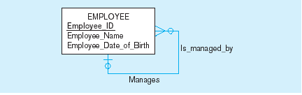

Figure 5-17 Mapping a unary 1:N relationship
(a) EMPLOYEE entity with unary relationship
(b) EMPLOYEE relation with recursive foreign key

Slide 28
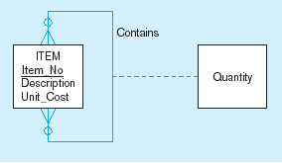
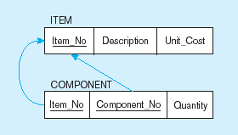
Figure 5-18 Mapping a unary M:N relationship
(a) Bill-of-materials relationships (M:N)
(b) ITEM and COMPONENT relations

Slide 29
Transforming EER Diagrams into Relations (cont.)
Mapping Ternary (and n-ary) Relationships
  One relation for each entity and one for the associative entity
  Associative entity has foreign keys to each entity in the relationship

Slide 30
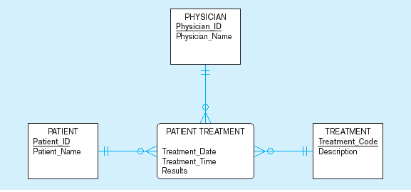
Figure 5-19 Mapping a ternary relationship
a) PATIENT TREATMENT Ternary relationship with associative entity

Slide 31
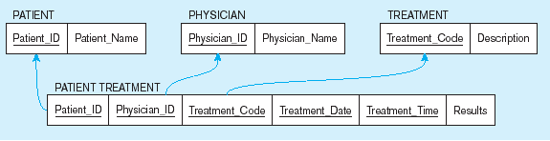
Figure 5-19 Mapping a ternary relationship (cont.)
b) Mapping the ternary relationship PATIENT TREATMENT
Remember that the primary key MUST be unique
This is why treatment date and time are included in the composite primary key
But this makes a very cumbersome key…
It would be better to create a surrogate key like Treatment#

Slide 32
Transforming EER Diagrams into Relations (cont.)
Mapping Supertype/Subtype Relationships
  One relation for supertype and for each subtype
  Supertype attributes (including identifier and subtype discriminator) go into supertype relation
  Subtype attributes go into each subtype; primary key of supertype relation also becomes primary key of subtype relation
  1:1 relationship established between supertype and each subtype, with supertype as primary table

Slide 33
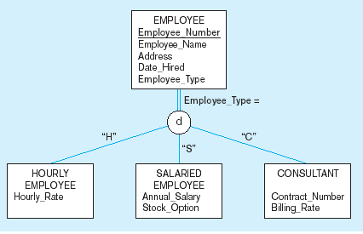
Figure 5-20 Supertype/subtype relationships

Slide 34
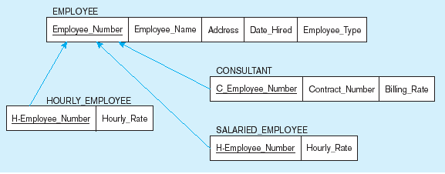
Figure 5-21
Mapping Supertype/subtype relationships to relations
These are implemented as one-to-one relationships

